Slide 1
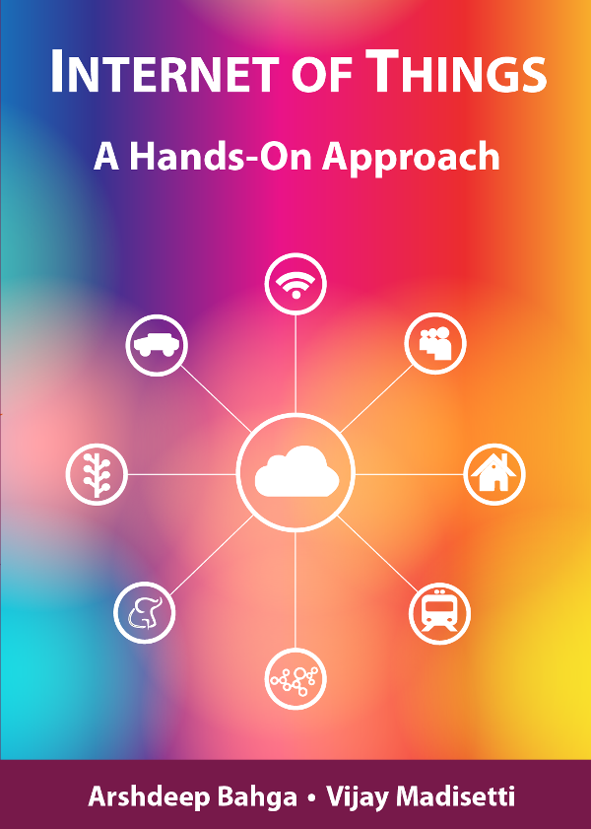
Introduction to IoT
By. Chandramouli Haldar

Slide 2
Deﬁnition of IoT
❖ The Internet of Things is the network of physical objects or "things" embedded with electronics, software and sensors, in a network connectivity, which enables these objects to collect and exchange data.
❖ It allows objects to be sensed and controlled remotely across existing network infrastructure, creating opportunities for more direct integration between the physical world and computer-based systems, and resulting in improved efficiency, accuracy and economic benefit.

Slide 3
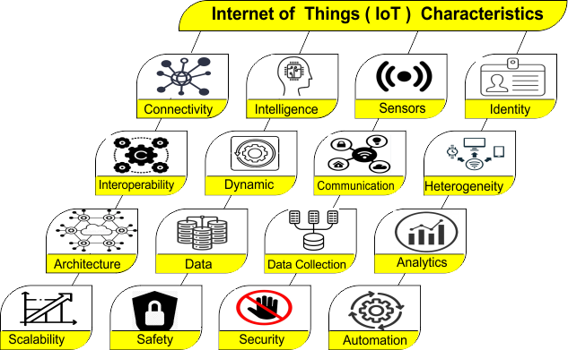

Slide 4
What is M2M Communication?
M2M (Machine-to-Machine) communication is a system where devices communicate with each other automatically without human involvement.
How it Works
Devices (machines) are connected through a network
They collect, send, and receive data
Communication can happen via:
  Wired networks
  Wireless networks (WiFi, cellular, LoRa)
Key Features
No human interaction required
Automatic data exchange
Real-time monitoring and control

Slide 5
M2M vs IoT
Feature | M2M (Machine-to-Machine) | IoT (Internet of Things)
Definition | Direct communication between machines | Network of connected devices via internet
Communication | Device ↔ Device | Device ↔ Cloud ↔ User
Network Type | Private / closed network | Internet-based (public network)
Human Involvement | Not required | Users can monitor/control via apps
Scalability | Limited | Highly scalable
Data Processing | Mostly local | Cloud + Edge processing
Protocols | Proprietary or fixed | Standard protocols (HTTP, MQTT)
Flexibility | Low | High

Slide 6
Evolution of IoT
📜 History of IoT
The concept of the Internet of Things (IoT) was first introduced in 1999 at the Auto-ID Center of MIT (Massachusetts Institute of Technology).
At that time, Radio-frequency identification (RFID) was seen as a prerequisite for the IoT at that point. If all objects and people in daily life were equipped with identifiers, computers could manage and inventory them. Besides using RFID, the tagging of things may be achieved through such technologies as near field communication, barcodes, QR codes, blue-tooth, and digital watermarking
🌐 Present-Day IoT
Today, IoT is everywhere—in homes, industries, vehicles, hospitals, and cities.
Devices are connected using Wi-Fi, 5G, LoRa, Zigbee, and other communication methods.
Data from sensors is sent to cloud platforms or edge devices for processing and decision-making.
Artificial Intelligence (AI) and Big Data now play a major role in making IoT systems smarter.
Over 15 billion IoT devices are active globally (and growing fast!)

Slide 7
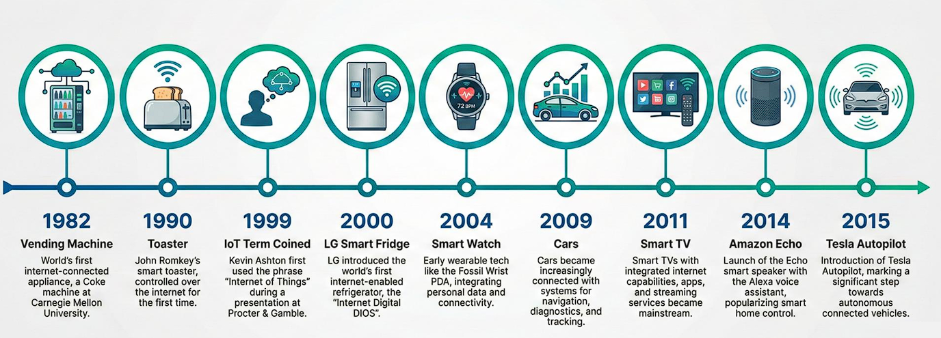
History of IoT

Slide 8
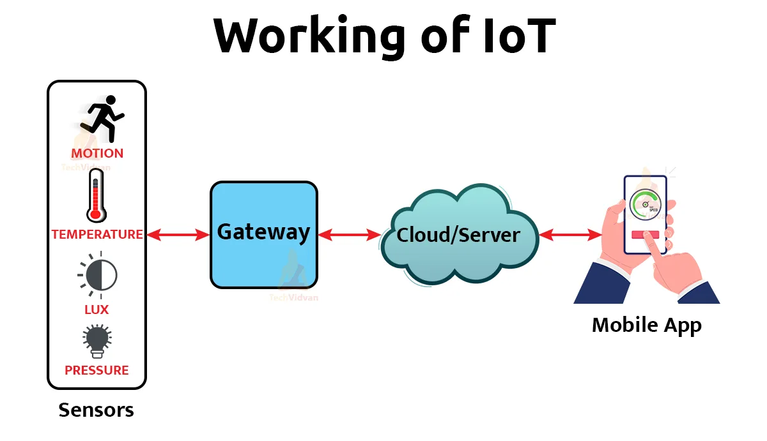
How IoT Systems Works
Sensors / Devices
  Collect data from the environment
  Example: Temperature, motion, light, GPS
Connectivity
  Sends data to the cloud or other devices
  Example: Wi-Fi, Bluetooth, LoRa, 5G
Data Processing
  The cloud or a local device processes the data
  Example: Checking if temperature is too high
Action / Output
  A response is triggered based on the data
  Example: Send alert, turn on fan, or display info in an app

Slide 9
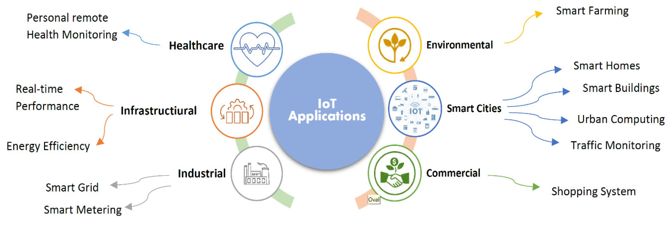
Applications of IoT

Slide 10
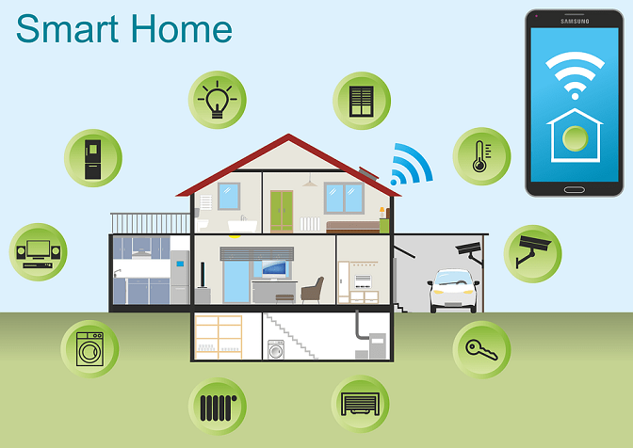
How IoT Systems Works Example

Slide 11
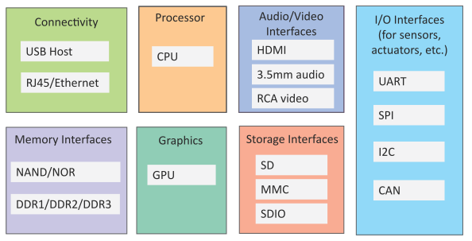
Generic Components of an IoT Device
An IoT device may consist of several interfaces for connections to other devices, both wired and wireless.
  I/O interfaces for sensors
  Interfaces for internet connectivity
  Memory and storage interfaces
  Audio/video interfaces

Slide 12
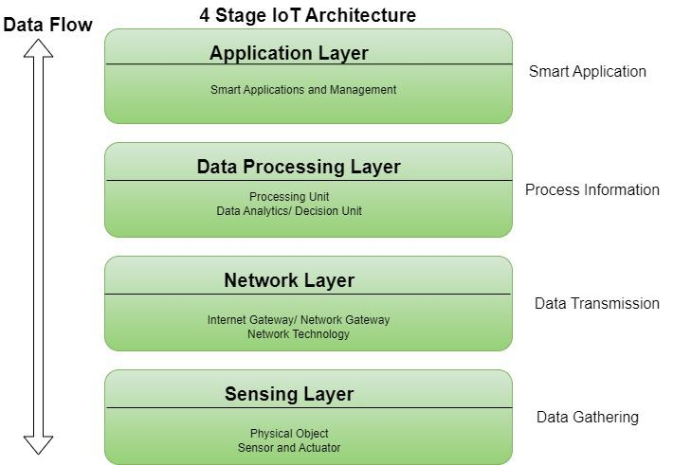
4 Stages of IoT Architecture

Slide 13
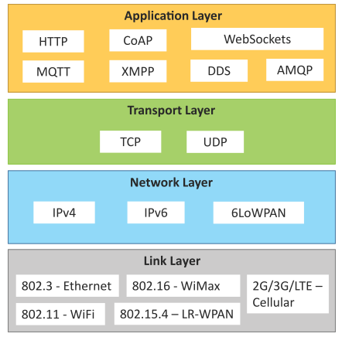
IoT Protocols
Link Layer
  802.3 – Ethernet
  802.11 – WiFi
  802.16 – WiMax
  802.15.4 – LR-WPAN
  2G/3G/4G
Network/Internet Layer
  IPv4
  IPv6
  6LoWPAN
Transport Layer
  TCP
  UDP
Application Layer
  HTTP
  CoAP
  WebSocket
  MQTT
  XMPP
  DDS
  AMQP

Slide 14
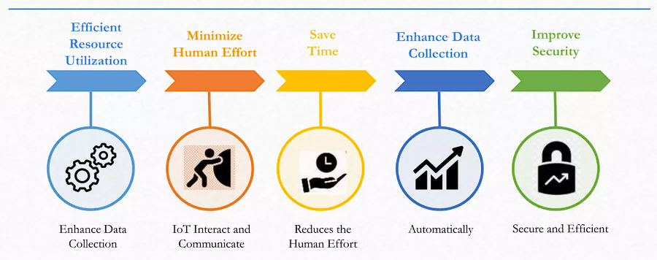
Advantages of IoT

Slide 15
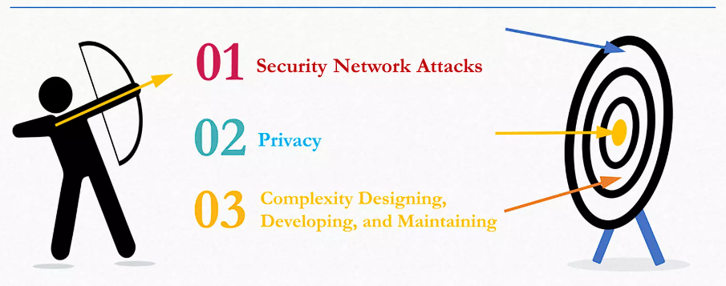
Disadvantages of IoT

Slide 16
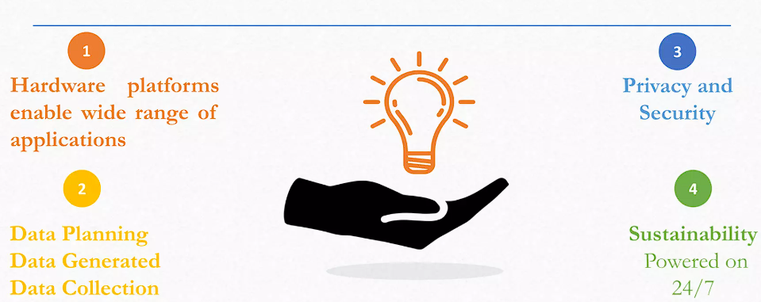
Challenges in IoT

Slide 17
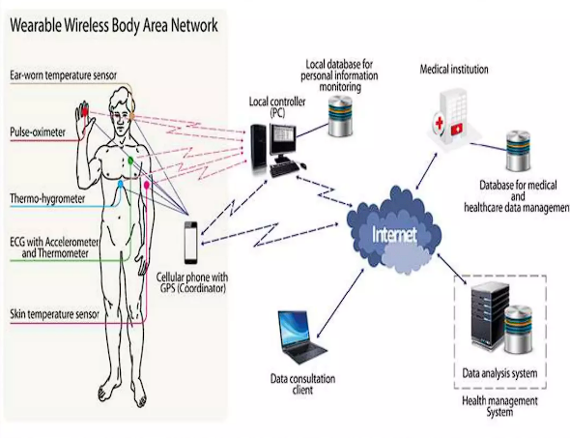
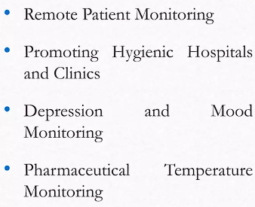
IoT in Health Care

Slide 18
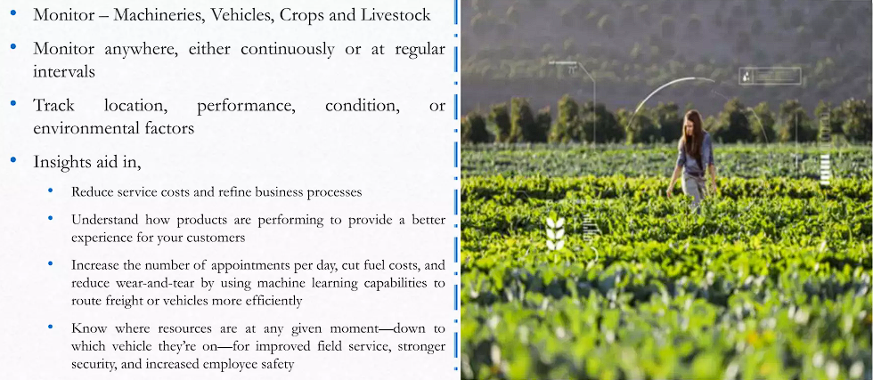
Remote Monitoring

Slide 19
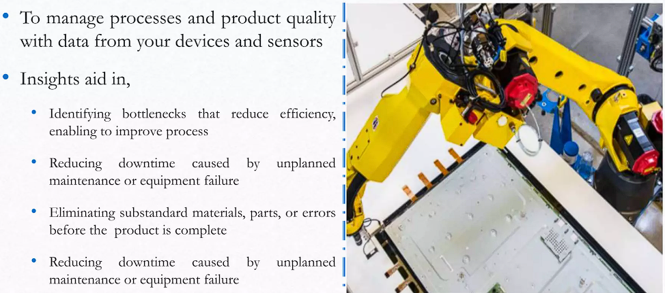
Manufacturing Efficiency

Slide 20
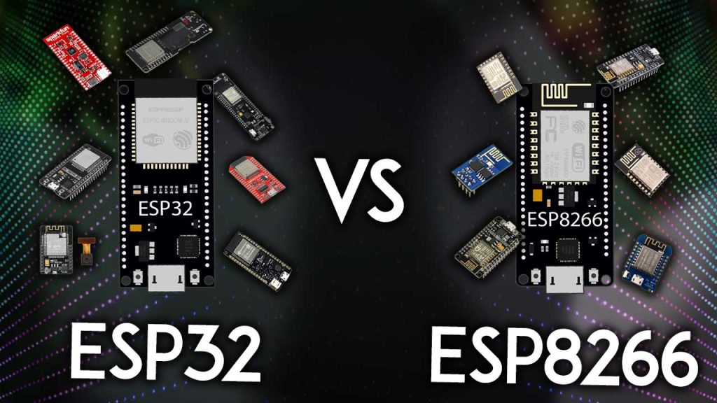


ESP
ESP32 vs ESP8266
68
Menu

Slide 21

ESP8266
Introduction to ESP8266
What is NodeMCU? The NodeMCU (Node MicroController Unit) is an open-source software and hardware development environment built around an inexpensive System-on-a-Chip (SoC) called the ESP8266.
Chip Set
ESP8266EX, 32-bit Tensilica L106
Operating Voltage
3.3 V
Operating Frequency
Up to 80 MHz (160 MHz overclocking supported)
Wi-Fi
Built-in 2.4 GHz Wi-Fi (802.11 b/g/n)
GPIO
Up to 17 GPIO pins and 1 ADC channel (A0)
PWM
Software-based PWM available on GPIO pins for controlling LEDs, motors, and other devices
Communication Interfaces
UART, SPI, and I²C support
69
Menu

Slide 22
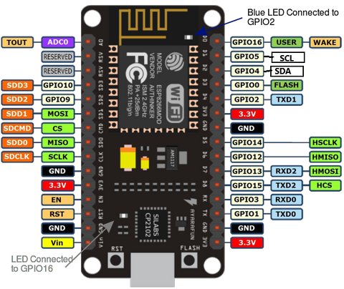
ESP8266
NodeMCU ESP8266 Pinout
70
Menu

Slide 23
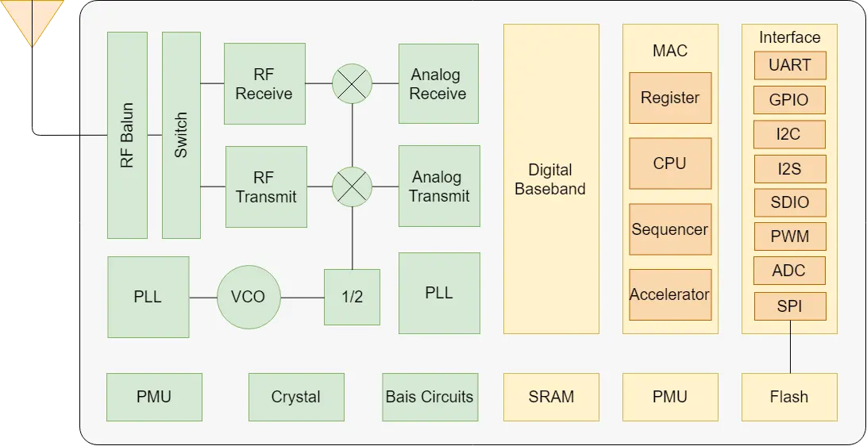
ESP8266
ESP8266 Block Diagram
71
Menu

Slide 24





ESP32
Introduction to ESP32
Key Features:
What is ESP32?
Built-in Wi-Fi (2.4 GHz) and Bluetooth (BLE + Classic)
A low-cost, powerful microcontroller developed by Espressif
Dual-core processor (up to 240 MHz)
Chipset : Tensilica Xtensa Dual-Core 32-bit LX6
Multiple GPIO pins (digital & analog)
Successor to ESP8266 with advanced features
Supports ADC, DAC, PWM, UART, SPI, I2C
Designed for IoT (Internet of Things) applications
520 KB of internal SRAM, 448 KB of ROM
72
Menu
Notes:
ESP32 is the successor to the ESP8266, with Bluetooth and dual-core.

Slide 25




ESP32
Why ESP32 is Better?
Ideal for IoT, automation, and embedded systems
Smart home systems
Wearable devices
More powerful than Arduino UNO
Cost-effective and widely supported
Common Applications:
Tap the tiles on the right →
Industrial automation
Wireless sensor networks
73
Menu
Notes:
Discuss why we prefer ESP32 for IoT projects.

Slide 26
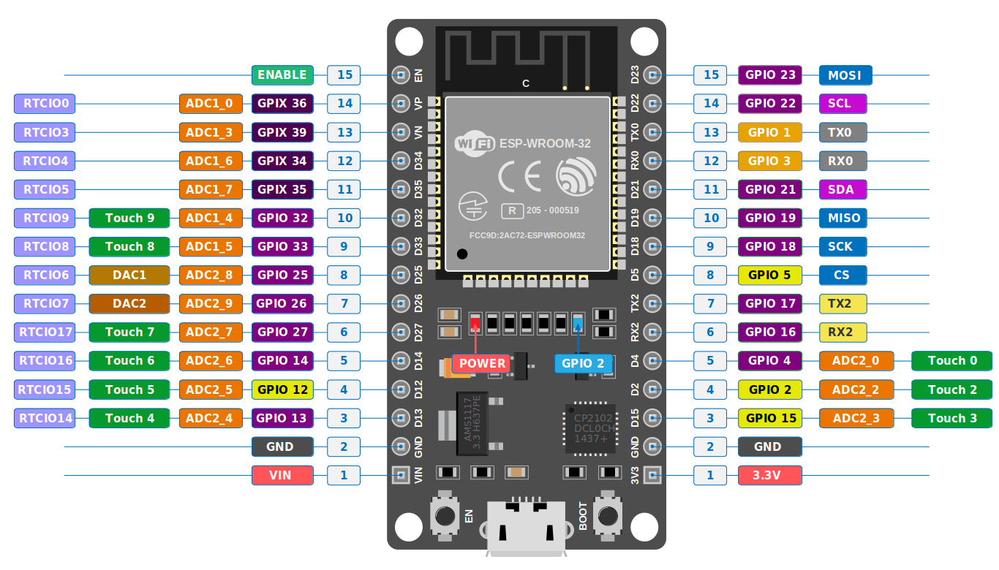
ESP32
ESP32 Pinout
74
Menu

Slide 27
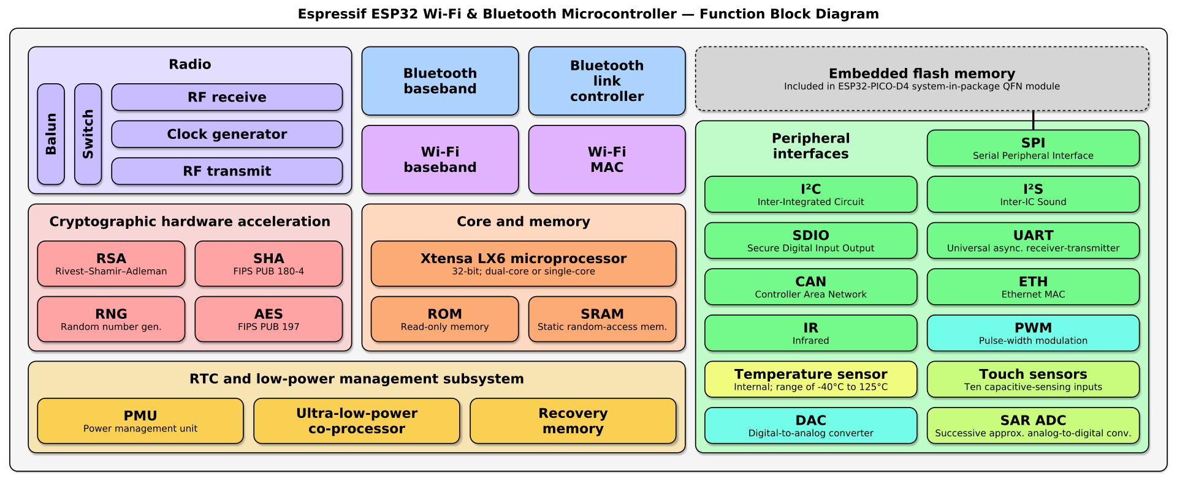
ESP32
ESP32 Function Block Diagram
75
Menu

Slide 28
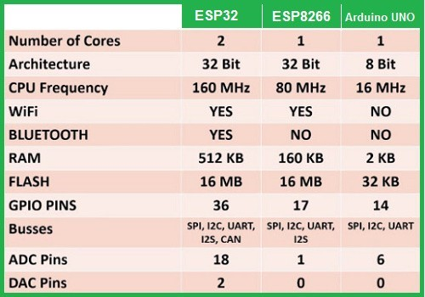
ESP32
ESP32 vs ESP8266 vs Arduino UNO
76

Slide 29
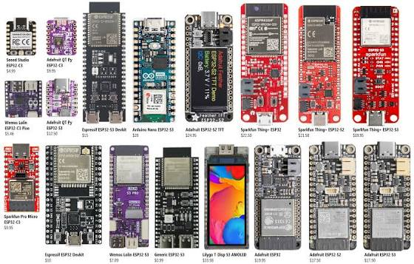
ESP32
ESP Boards
77
Menu

